Slide 2
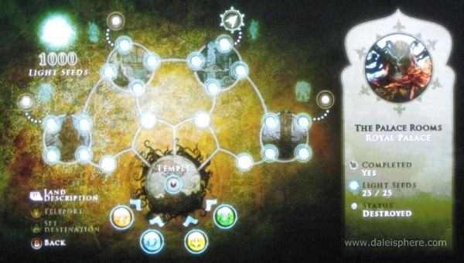
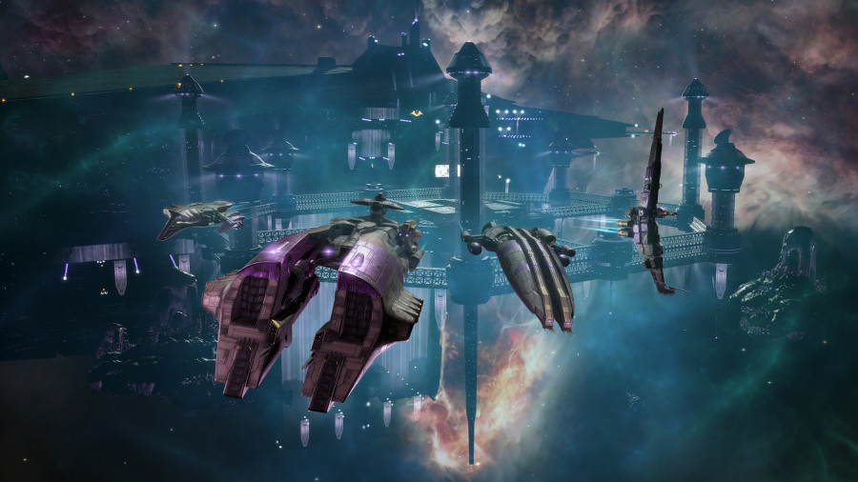
Features points
In depth skill tree, with tons of different ways to play the game.
Huge replayability, choose a different story and skills each time you play.
Hundreds of different space ships to collect.

Slide 3

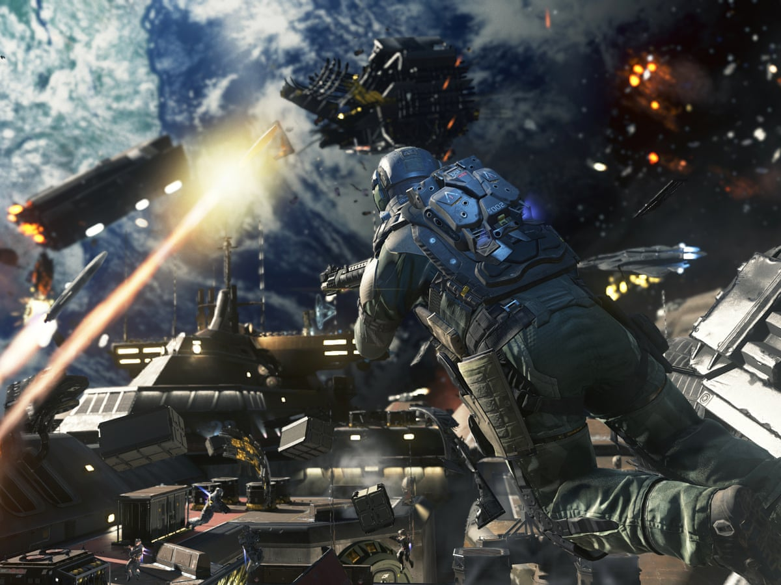
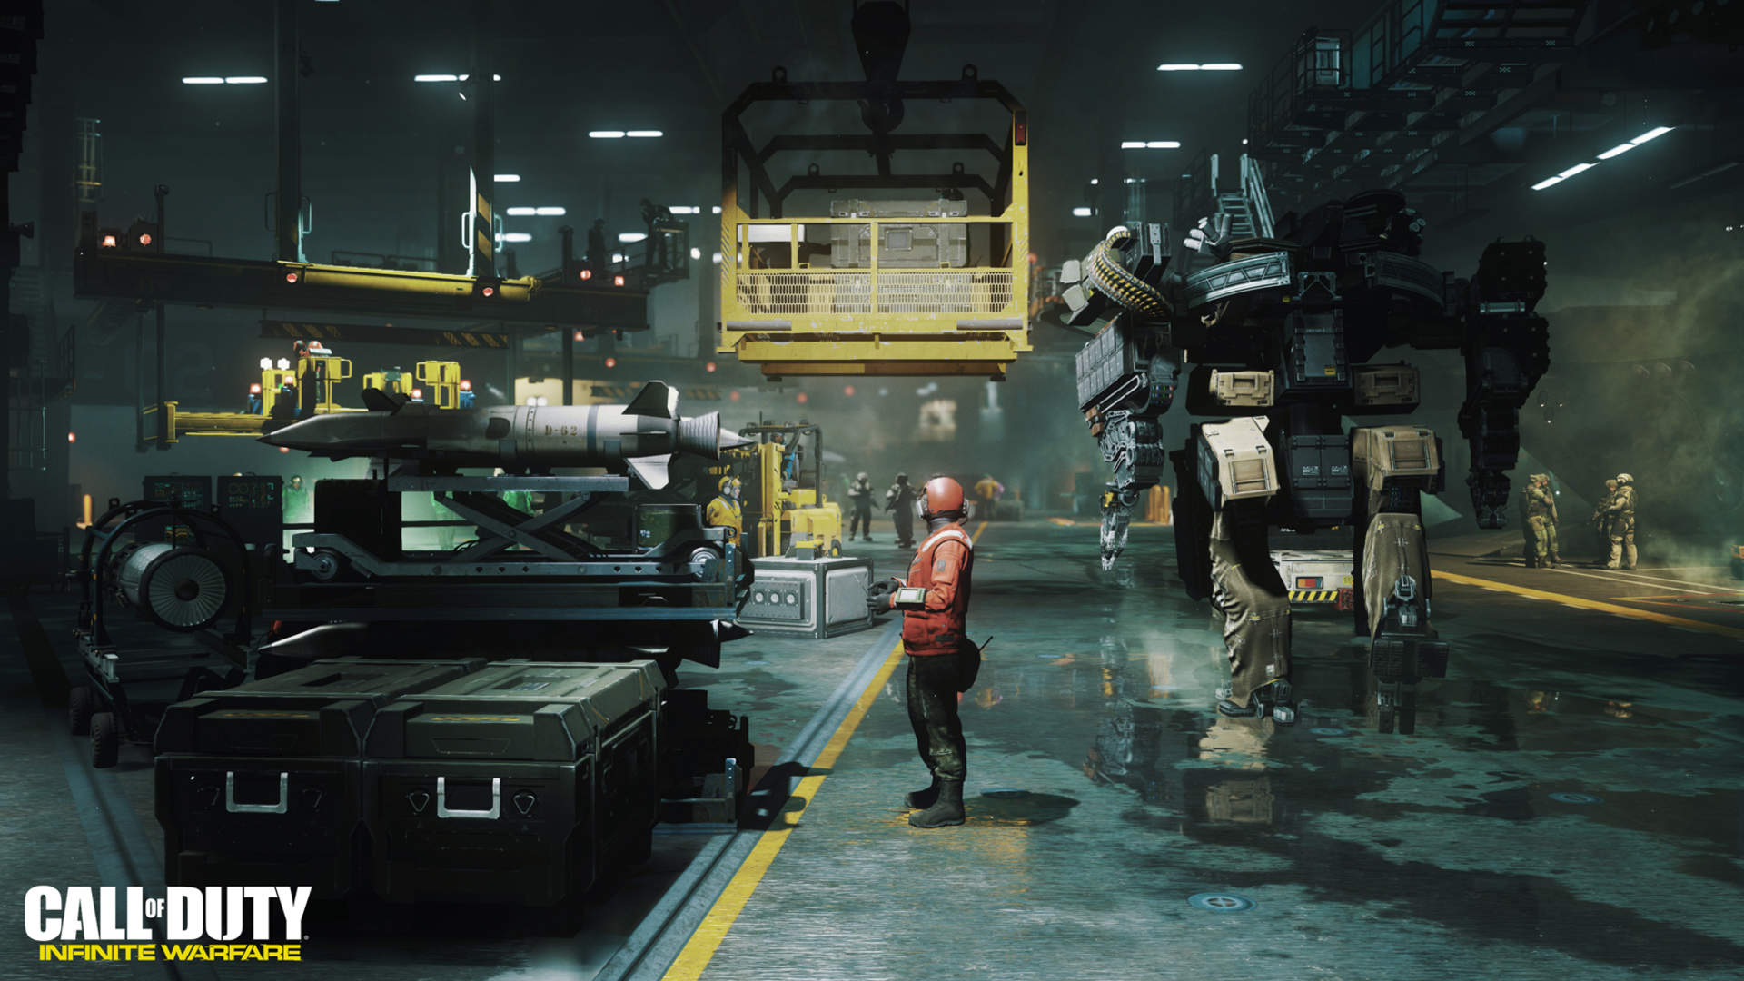
Market analysis
Similar to
Eve Online
Prince of Persia
Need for speed (space)
Call of duty infinte warfare

